Slide 1
MODFLOW 6 LGR

Slide 2
Local Grid Refinement
Why use LGR?
Resolution can be increased in areas of interest
Can be used with regular MODFLOW grids
Child models can be extracted and run separately
Why not use it?
More complicated to work with
Concerns about accuracy
Limited GUI support
It used to be relatively slow and could have convergence problems

Slide 3
Approaches
Old School (Telescopic Mesh Refinement)
Heads or flows from a parent model are used to set boundary conditions for a child model
MODFLOW-LGR
Parent and child models are iteratively coupled
MODFLOW-USG
Parent and child models are built into a single mesh
MODFLOW 6
Parent and child models are solved simultaneously in a single matrix solution

Slide 4
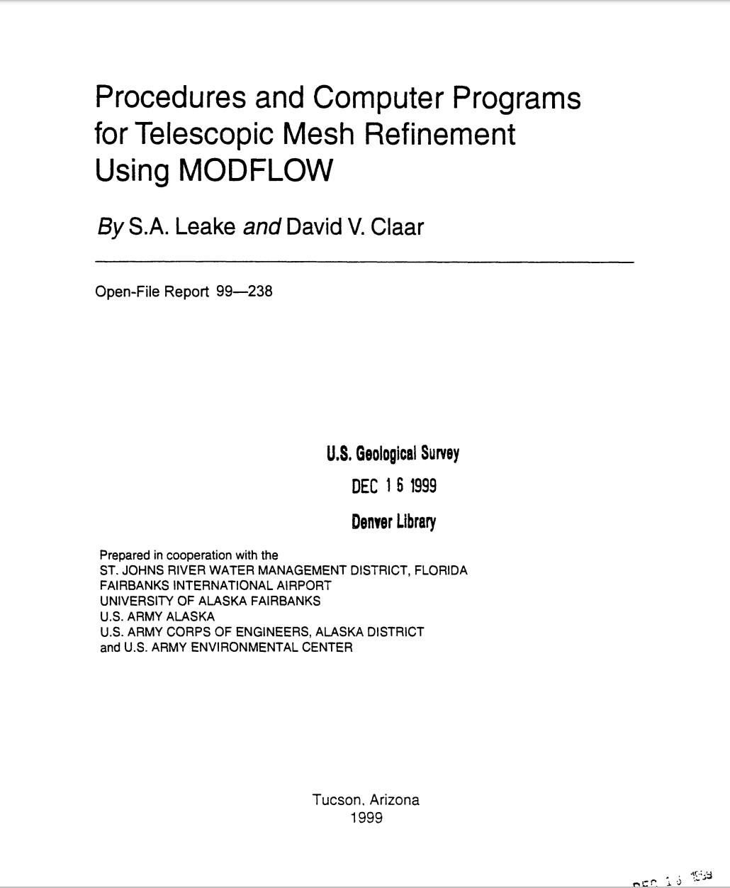
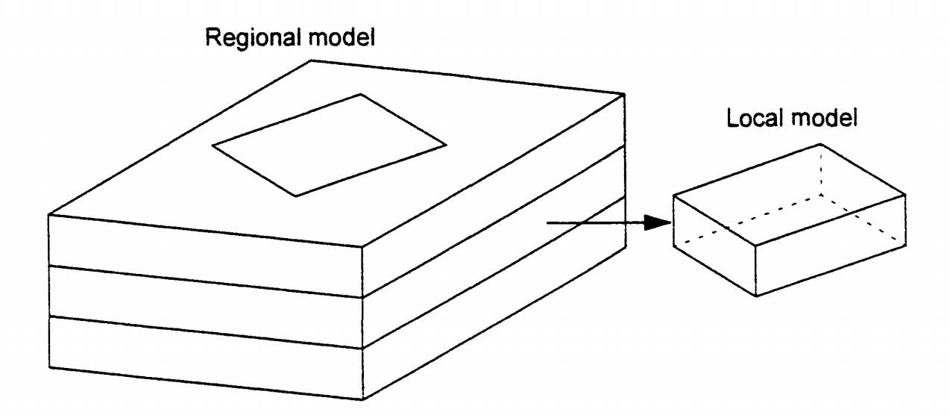
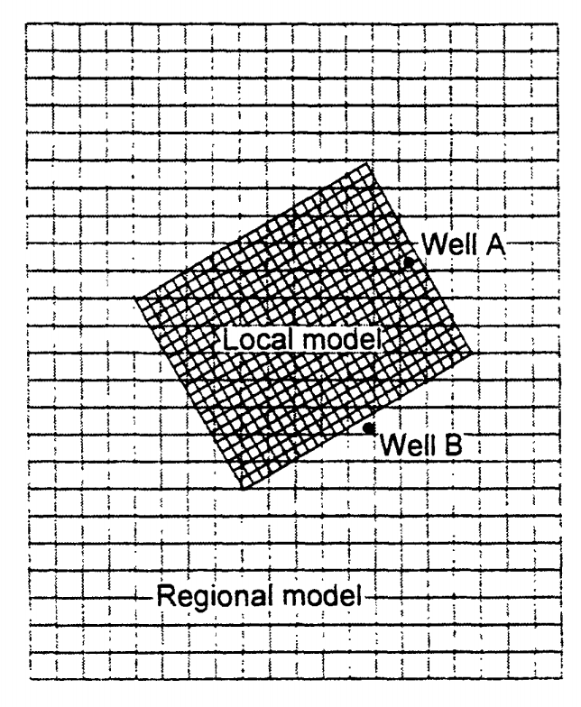
1. TMR
Heads and flows from parent model used as boundary conditions for child model
Easy to do
Some GUI support (e.g. Groundwater Vistas)
Child does not have to be coincident with parent
No automatic feedback from child to parent

Slide 5
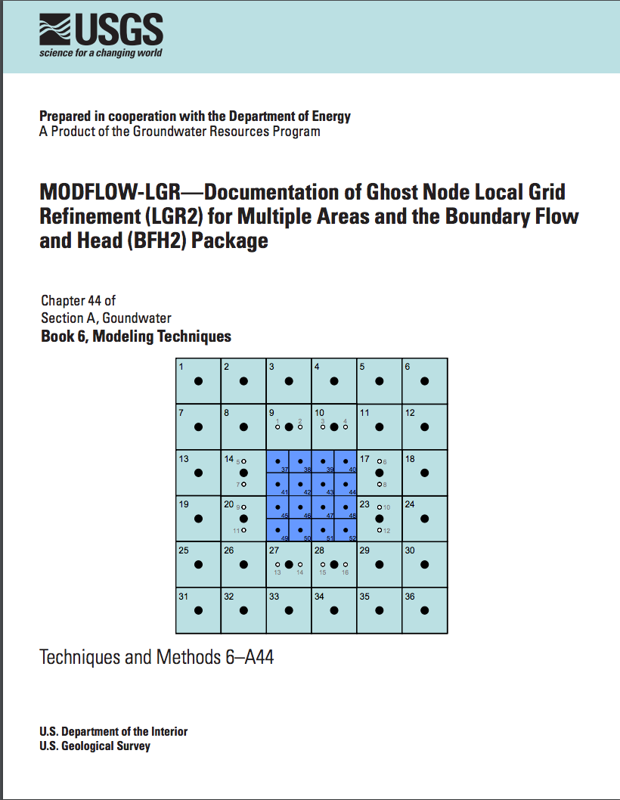
2. MODFLOW-LGR
Parent and child models are iteratively coupled
Child models can be used separately
May be slow convergence
Limited GUI support
Restrictions on parent/child configurations

Slide 6

3. MODFLOW-USG
Parent, child, grandchildren, cousins, etc. are built into a single mesh
Some GUI support
Everything solved in a single matrix (fast and robust)
Need to reconstruct mesh to add a new child

Slide 7

4. MODFLOW 6
Can do single mesh or multiple models
Everything solved in a single matrix (fast and robust)
No GUI support

Slide 8
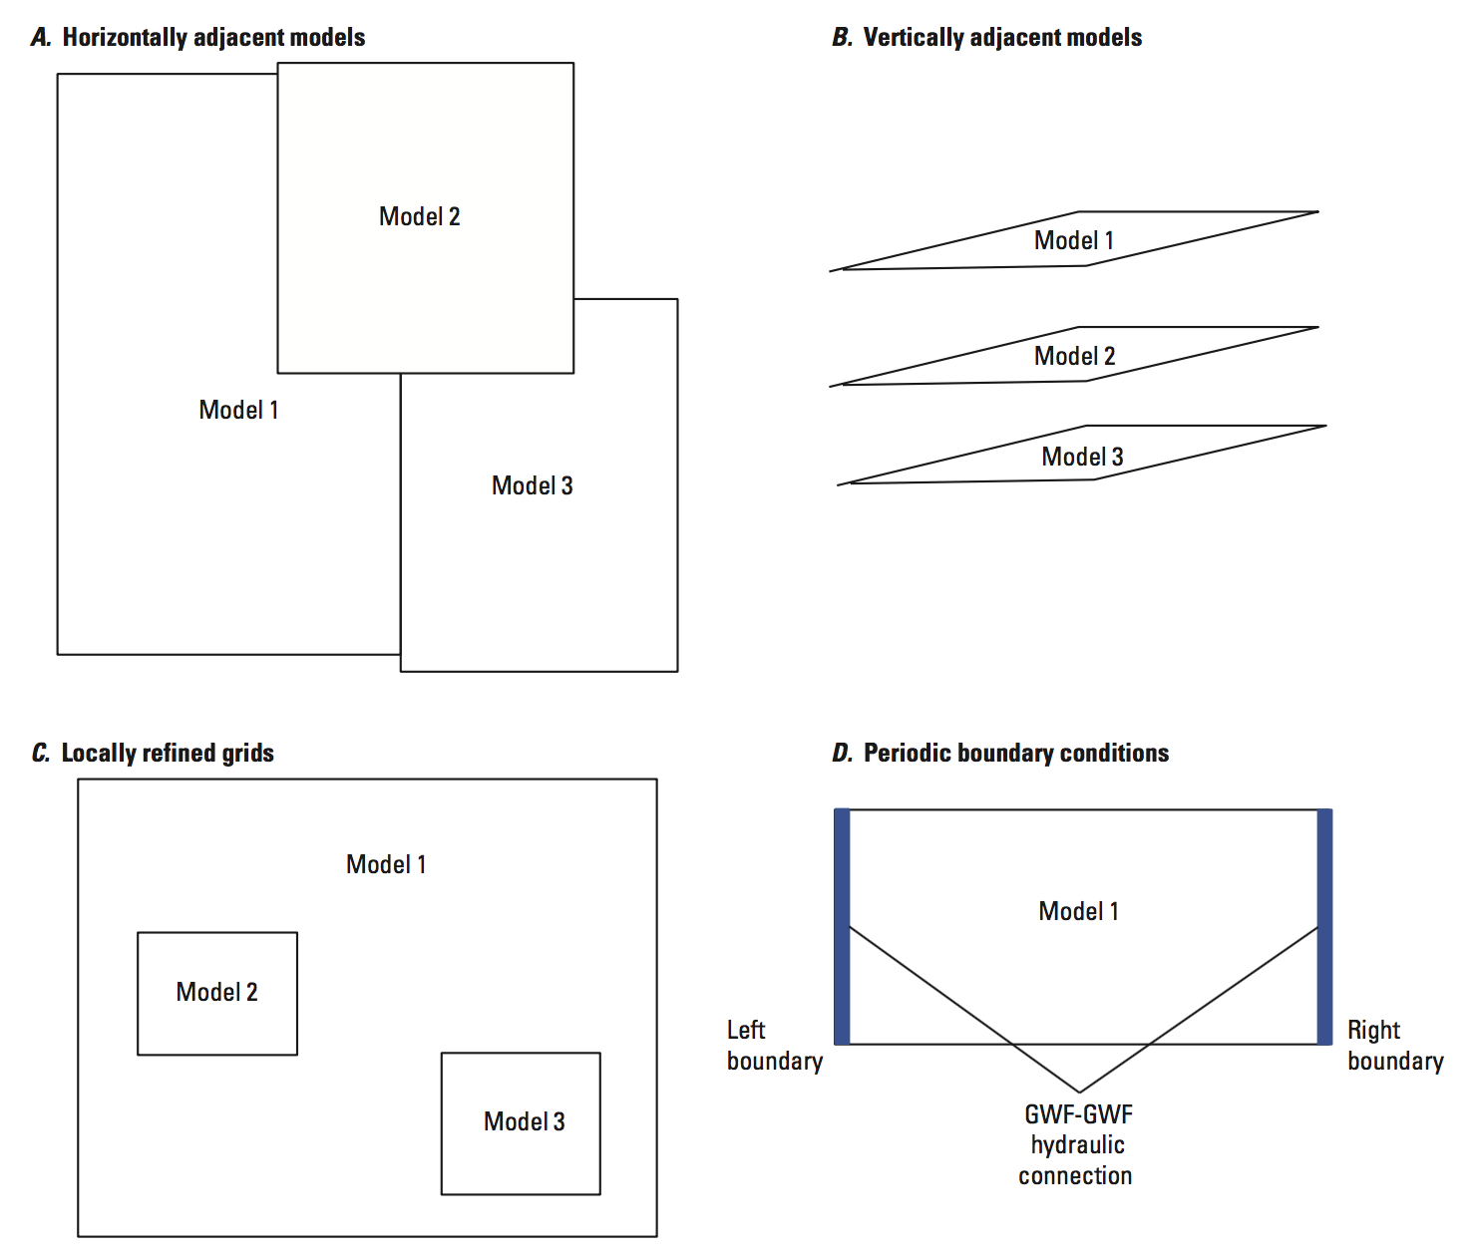
MODFLOW 6 LGR
Construct parent and child models
Use IDOMAIN to inactivate parent model where child model exists
Use the GWF6-GWF6 Exchange (specified in mf6.nam) to couple the models

Slide 9
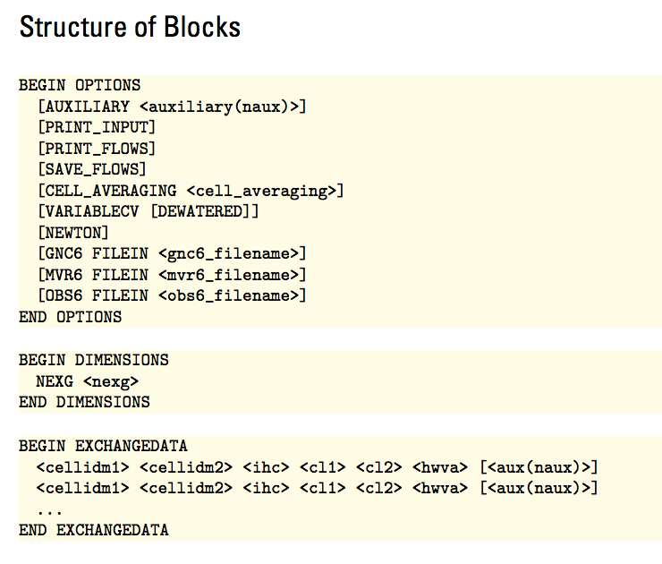
GWF6-GWF6 Exchange

Slide 10

Map View
Cell in model 1
hwva
cl1
cl2
Cell in model 2
ihc = 1 or 2 (horizontal connection)

Slide 11
Cross-Section View
TOP
TOP
BOT
BOT
ihc = 1
ihc = 2
“vertically staggered”

Slide 12
Vertical Connections
hwva is the area of the connection
ihc = 0
cl1 is the half cell thickness of the cell in model 1
cl2 is the half cell thickness of the cell in model 2

